Slide 1
Don’t be a tattle tale: Preventing leakages through data dependencies on access control protected data
Primal Pappachan, Shufan Zhang, Xi He, Sharad Mehrotra
Pennsylvania State University, University of Waterloo, University of California, Irvine

Slide 2
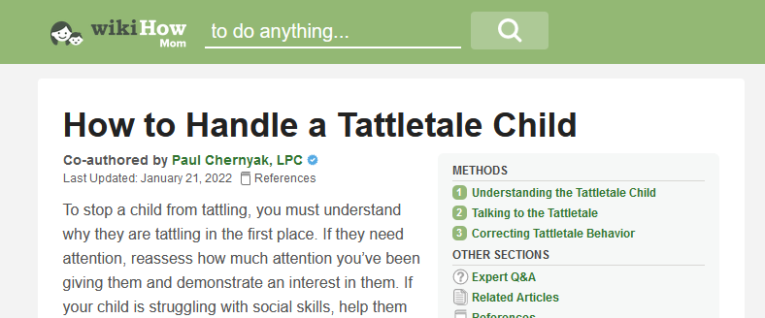
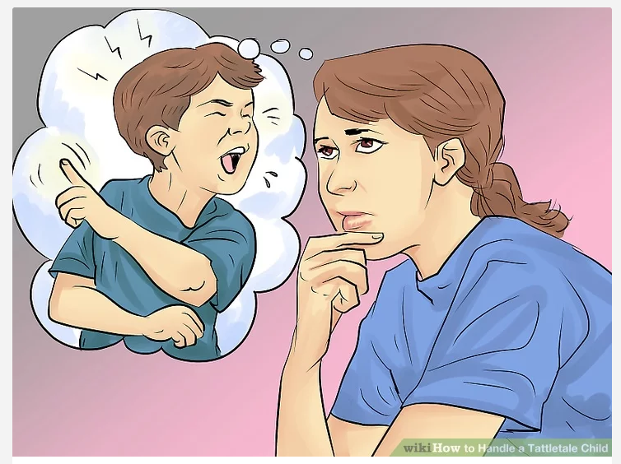
What is a Tattle-Tale?

Slide 3
Tattle-Tale in Databases
Eid | EName | Zip | State | Role | WorkHrs | SalPerHr
34 | Tina | 45678 | WA | Student | 20 | 40
56 | Bobby | 54321 | CA | Faculty | 40 | 200
78 | Dale | 53567 | CA | Faculty | 40 | 200
12 | Khan | 54321 | CA | Staff | 30 | 70
t₁
t₂
t₃
t₄
[State = CA, Role] → [SalPerHr]

Slide 4
Tattle-Tale in Databases
Eid | EName | Zip | State | Role | WorkHrs | SalPerHr
34 | Tina | 45678 | WA | Student | 20 | 40
56 | Bobby | 54321 | CA | Faculty | 40 | 200
78 | Dale | 53567 | CA | Faculty | 40 | 200
12 | Khan | 54321 | CA | Staff | 30 | 70
t₁
t₂
t₃
t₄
Using [State = CA, Role] → [SalPerHr] and Dale’s SalPerHr
Bobby’s SalPerHr can be inferred

Slide 5
Our Goal
Detect and prevent leakages due to data dependencies by hiding “minimal” number of cells
Hide Bobby’s State for protecting his SalPerHr
[State = CA, Role] → [SalPerHr]
Eid | EName | Zip | State | Role | WorkHrs | SalPerHr
34 | Tina | 45678 | WA | Student | 20 | 40
56 | Bobby | 54321 | CA | Faculty | 40 | 200
78 | Dale | 53567 | CA | Faculty | 40 | 200
12 | Khan | 54321 | CA | Staff | 30 | 70
t₁
t₂
t₃
t₄

Slide 6
Our Goal
Detect and prevent leakages due to data dependencies by hiding “minimal” number of cells
Additionally hide Bobby’s Zip for protecting his State
Zip→ State
Eid | EName | Zip | State | Role | WorkHrs | SalPerHr
34 | Tina | 45678 | WA | Student | 20 | 40
56 | Bobby | 54321 | CA | Faculty | 40 | 200
78 | Dale | 53567 | CA | Faculty | 40 | 180
12 | Khan | 54321 | CA | Staff | 30 | 70
t₁
t₂
t₃
t₄

Slide 7
Extent of Leakage
Tested on Tax dataset which contains address and tax information of individuals
14 attributes and 10 associated dependencies
E.g., if two persons live in the same state, the one earning a lower salary has a lower tax rate
Salary attribute marked as sensitive and tested against a real-world adversary
Holoclean [VLDB2017] which is a state-of-the-art tool for inferring missing data.
Able to reconstruct the actual values of sensitive cells 100% of the time highlighting the importance of preventing leakages through dependencies

Slide 8
Prior Work
Design time​ prevention
Weak security model.
[Delugach&Hinke, TKDE'96],
[Yip&Levitt, CSF'98], etc.
[Brodsky et al, TKDE'00]
Query time​ prevention
Poor data availability.
Randomized algorithms (DP/OSDP)
Not practical for query answering
[Kotsogiannis et al, ICDE'20]
Suppresses too many cells.
[Miklau & Suciu, SIGMOD'04]
Perfect secrecy on views
None of the prior works have studied leakage on sensitive data due to data dependencies with strong security guarantees and practical utility.

Slide 9
Main Contributions
*Covered in this presentation
**Refer to the full paper
Formalizing leakage attack based on two types of data dependencies
Denial Constraints
Function-based Constraints
Defining a security model
Tattle-Tale Condition for Leakage Detection
Full Deniability
Relaxation of the assumptions in the model
Developing algorithmic solutions to implement security model
With focus on Utility, Efficiency, and Convergence
Optimizations to improve performance
Evaluated on 2 different datasets
End-to-end System implementation in MySQL

Slide 10
Formalizing Leakage Attacks
Access Control Policies mark cells in the database as sensitive

Slide 11
Formalizing Leakage Attacks
Data Dependencies causes the leakage
Expressed in the form of Denial Constraints (DCs)
$δ_{1}^{\sim }:∀t_{i}, t_{j}¬\left((t_{i}[A]=t_{j}\left[A\right]\right)\bigwedge{(t_{i}\left[B\right]≠t_{j}[B]))}$

Slide 12
Formalizing Leakage Attack
$$t_{1}$$
$$t_{2}$$
c₁
c₂
c₃
c₄
c₅
c₆
1
2
2
1
2
3
$$∀A_{i}Dom\left(A_{i}\right)=\{1, 2, 3\}$$
A₁
A₂
A₃
A₁
A₂
A₃
$$V_{0}$$
$$V_{1}$$
c₁
c₂
c₃
c₄
c₅
c₆
c₁
c₂
c₃
c₄
c₅
c₆
*
*
*
*
*
*
1
2
3
1
2
*
Base view
Adversary Infers
Adversary Infers
$$c_{6}=\{1, 2, 3\}$$
$$c_{6}=\{1, 2, 3\}$$

Slide 13
Formalizing Leakage Attack
c₁
c₂
c₃
c₄
c₅
c₆
1
2
2
1
2
3
A₁
A₂
A₃
A₁
A₂
A₃
$$V_{0}$$
$$V_{1}$$
c₁
c₂
c₃
c₄
c₅
c₆
c₁
c₂
c₃
c₄
c₅
c₆
*
*
*
*
*
*
1
2
3
1
2
*
Base view
$$δ^{\sim }:A_{1} →A_{3}$$
$$δ_{1}:¬\left(c_{1}=c_{4} ∧c_{3}≠c_{6}\right)$$
Adversary Infers
Adversary Infers
$$c_{6}=\{1, 2, 3\}$$
$$c_{6}=\{3\}$$

Slide 14
Formalizing Leakage Attack
c₁
c₂
c₃
c₄
c₅
c₆
1
2
2
1
2
3
A₁
A₂
A₃
A₁
A₂
A₃
$$V_{0}$$
$$V_{2}$$
c₁
c₂
c₃
c₄
c₅
c₆
c₁
c₂
c₃
c₄
c₅
c₆
View $V_{2}$ achieves Full Deniability i.e., adversary is unable to infer nothing more than the base view $V_{0}$
I$\left(c_{i}\right| V^{`},δ) =\text{I}\left(c_{i}\right| V_{0}, δ)$
$$∀c_{i}∈C^{S}, ∀δ∈S_{Δ}$$
*
*
*
*
*
*
*
2
3
1
2
*
Base view
$$δ^{\sim }:A_{1} →A_{3}$$
$$δ_{1}:¬\left(c_{1}=c_{4} ∧c_{3}≠c_{6}\right)$$
Adversary Infers
Adversary Infers
$$c_{6}=\{1, 2, 3\}$$
$$c_{6}=\{1, 2, 3\}$$

Slide 15
What caused leakage?
Shared View
$$V_{1}$$
$$¬(\left(1=1\right) ⋀(3≠ ∗)$$
1
2
3
1
2
*
True
?????
$$δ_{1}:¬\left(c_{1}=c_{4} ∧c_{3}≠c_{6}\right)$$
Truth value of the last predicate must
be False in a clean database
Tattle-Tale is True when all the other predicates, except the one with the sensitive cell, evaluate as True
$∴$ $c_{6}=\{3\}$ Remember that, in the base view we had $c_{6}$= {1, 2, 3}

Slide 16
What prevented leakage?
Shared View
$$V_{2}$$
*
2
3
1
2
*
$$¬(\left(∗ =1\right) ⋀(3<∗)$$
$$δ_{1}:¬\left(c_{1}=c_{4} ∧c_{3}≠c_{6}\right)$$
?????
?????
Either of the predicates could be False
Tattle-Tale is False when at least 1 other predicate evaluate as False or Unknown.
$$c_{6}=\left\{1, 2, 3 \right\}$$
Same as in the base view

Slide 17
Security model
Full deniability is achieved for a shared view if for all the hidden cells in that view and their dependency instantiations, Tattle-Tale Condition is False.

Slide 18
The Tail of Tattle-Tales!
$c_{6}$
…
…
…
…
…
$$c_{n}$$
100s of sensitive cells
$c_{12}$
….
$$c_{1}$$
$$c_{4}$$
$c_{2}$
$c_{5}$
$$c_{4}$$
$$c_{7}$$
$c_{2}$
$c_{5}$
$$c_{10}$$
$$c_{11}$$
Millions of cuesets
$$c_{3}$$
$$c_{2}$$
$$c_{6}$$
$$c_{5}$$
….
….
Lots and lots of hidden cells

Slide 19
Our approach
Input: Database $D$,
Set of Sensitive/Hidden Cells, Set of data dependencies,
Dependency Instantiation
False
Tattle-Tale
Condition?
True
Inference Detection
Output: View V that achieves full deniability
Inference Protection

Slide 20
Step 1: Instantiations…!
Dependency Instantiation
For each hidden cell, instantiate all the dependencies
Challenge: In the worst, there are ${|D|}^{2}$instantiations for each sensitive cell
Solution: We converted dependency instantiation operation into an efficient join query to reduce the complexity.
$$δ_{1}:¬(\left(c_{1}=c_{4}\right) ⋀\left(c_{2}=c_{5}\right) ⋀(c_{3}<c_{6})$$
$$δ_{2}:¬(\left(c_{7}=c_{4}\right) ⋀\left(c_{8}=c_{5}\right) ⋀(c_{9}<c_{6})$$
.
.
.
.
$δ_{\left|D^{2}\right|}:¬(\left(……….\right) ⋀\left(………..\right) ⋀(..…<c_{6})$

Slide 21
Step 2: Who are the Tattle-Tales?
Dependency Instantiation
Check for each hidden cell and their dependency instantiations
Termination Condition: If it returns False for all hidden cells and their dependency instantiations, then the view has achieved Full Deniability.
False
Tattle-Tale
Condition?
True
$$δ_{1}: ¬(\left(c_{1}=c_{4}\right) ⋀\left(c_{2}=c_{5}\right) ⋀(c_{3}<c_{6})$$
$$¬(\left(∗ =1\right) ⋀\left(2=2\right) ⋀(3<∗)$$

Slide 22
Step 2: Who are the Tattle-Tales?
Dependency Instantiation
Check for each hidden cell and their dependency instantiations
Termination Condition: If it returns False for all hidden cells and their dependency instantiations, then the view has achieved Full Deniability.
If it returns True for at least 1 of them, then there is leakage
False
Tattle-Tale
Condition?
True
$$δ_{1}: ¬(\left(c_{1}=c_{4}\right) ⋀\left(c_{2}=c_{5}\right) ⋀(c_{3}<c_{6})$$
$$¬(\left(1=1\right) ⋀\left(2=2\right) ⋀(3<∗)$$

Slide 23
Step 3: Cue them up!
Outputs cuesets for sensitive cells which satisfy the Tattle-Tale
Dependency Instantiation
Tattle-Tale
Condition?
False
$c_{6}^{∗}$
$$c_{n}^{∗}$$
True
Inference Detection
….
$c_{12}$
$$c_{1}$$
$$c_{4}$$
$c_{2}$
$c_{5}$
$$c_{4}$$
$$c_{7}$$
$c_{2}$
$$c_{4}$$
$$c_{10}$$

Slide 24
Step 4: Hide yo cells!
Choose cells to hide from the cuesets
Random Hiding leads to poor utility (Baseline)
Dependency Instantiation
Tattle-Tale
Condition?
False
True
$c_{6}^{∗}$
$$c_{n}^{∗}$$
Inference Detection
….
Inference Protection
$c_{12}$
$$c_{1}$$
$$c_{4}$$
$c_{2}$
$c_{5}$
$$c_{4}$$
$$c_{7}$$
$c_{2}$
$$c_{4}$$
$$c_{11}$$

Slide 25
Step 4: Hide yo cells, hide yo cells!
Choose cells to hide from the cuesets
Challenge: Selecting minimal cells to hide is NP-Hard.
Use a greedy heuristic based on Minimum Subset Cover
Run the approach again for newly hidden cells
Dependency Instantiation
Tattle-Tale
Condition?
False
True
Inference Detection
Inference Protection

Slide 26
Experimental Setup
Scan me for source code!
Datasets: Tax dataset [1], (larger) Hospital dataset [2]
Dependencies: Using a data profiling tool [2]. 11 dependencies on Tax dataset and 14 dependencies on Hospital dataset
Baselines:
Random Hiding for Inference Protection
Oblivious of Tattle-Tale for Inference Detection
End-to-end implementation of the system with steps done at pre-processing
Source code available on Github
[1] Chu et al. 2013 Discovering Denial Constraints
[2] Metanome

Slide 27
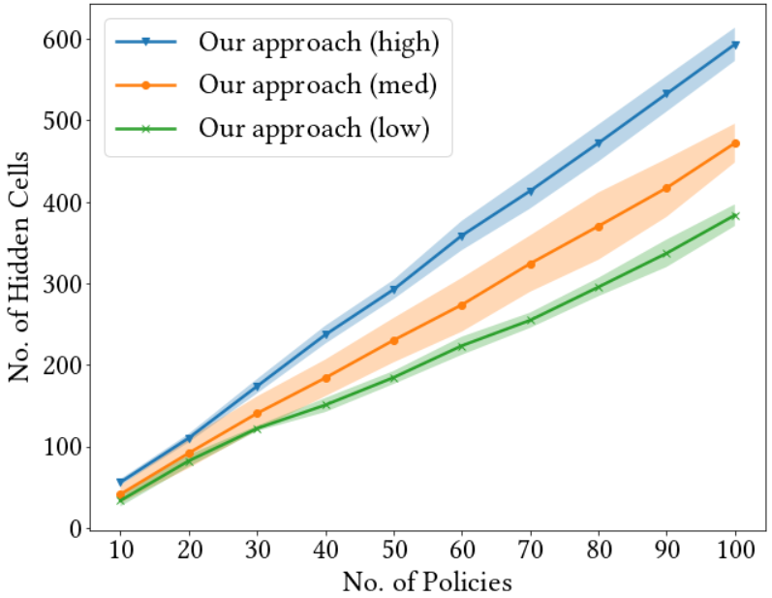
Impact of dependencies
If a sensitive cell
participates in more dependencies, number of hidden cells increases!
Number of Hidden Cells
Number of Sensitive Cells

Slide 28
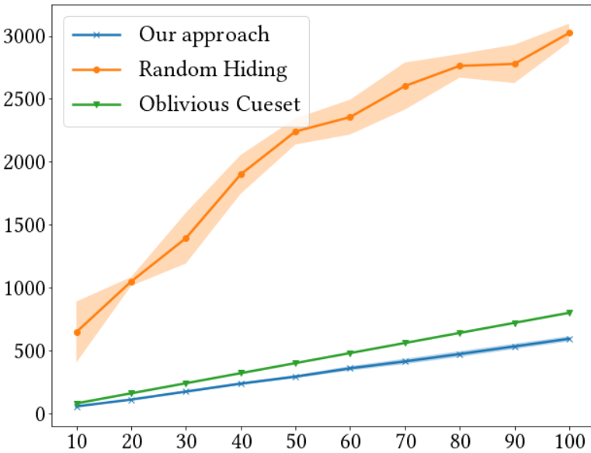
Utility Impact
Number of hidden cells increases linearly with our approach
Number of hidden cells increases exponentially when Random hiding used for Inference Protection!
Number of Hidden Cells
Number of Sensitive Cells

Slide 29
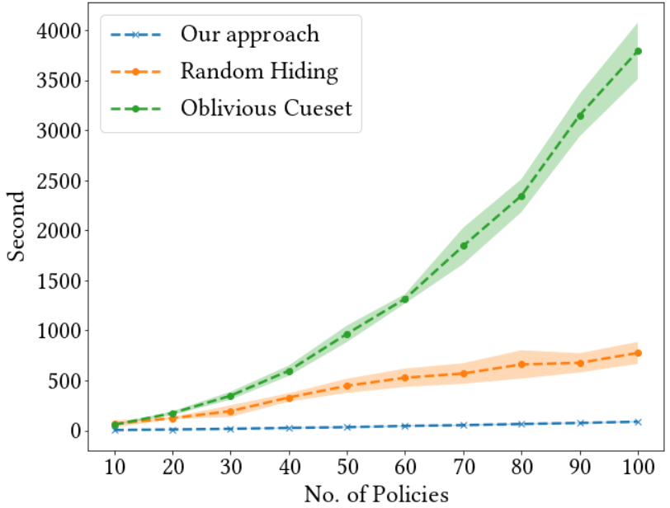
Performance Impact
What happens if when compared against the baselines?
Overhead minimal in our approach
High overhead when Tattle-Tale condition not used for generating cuesets
Time taken in Seconds
Number of Sensitive Cells

Slide 30
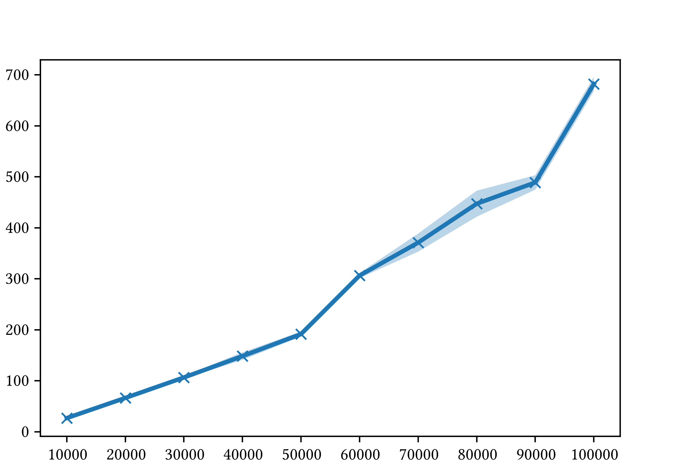
Performance Impact
What happens if when size of the database is increased?
Our approach scales linearly with respect to size of the database
Time taken in Seconds
Number of Sensitive Cells

Slide 31
Takeaways
Formalized a new type of leakage attacks based on dependencies such as Denial Constraints and Function-based Constraints
Defined a new security model of Full Deniability (FD) and Tattle-Tale Condition for achieving FD
Implemented algorithmic solutions for achieving FD on a given view
Several new research directions
Leakage with soft dependencies
Combining FD with randomized response methods such as DP, OSDP to release non-sensitive data partially

